Slide 1
ANLY535 deep learninG project
CNN Handwriting recognition project
- Xiaowei Wan

Slide 2
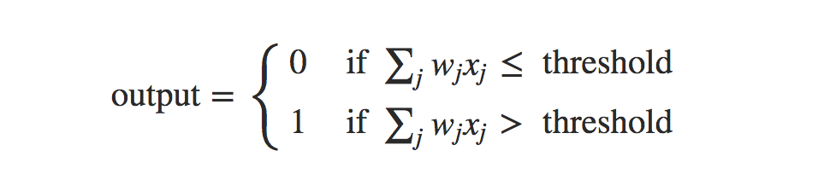
Handwriting recognition – Simple Neural Network (SNN)
weights, w1,w2,…w1,w2,…, real numbers expressing the importance of the respective inputs to the output.
By varying the weights and the threshold, we can get different models of decision-making.

Slide 3
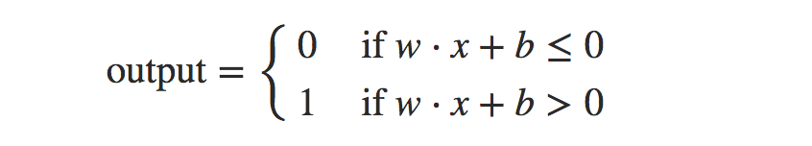
Handwriting recognition - SNN
Bias: Using the bias instead of the threshold, then the rule will be below:
Bias - a measure of how easy it is to get the output a 1 (in this case)

Slide 4
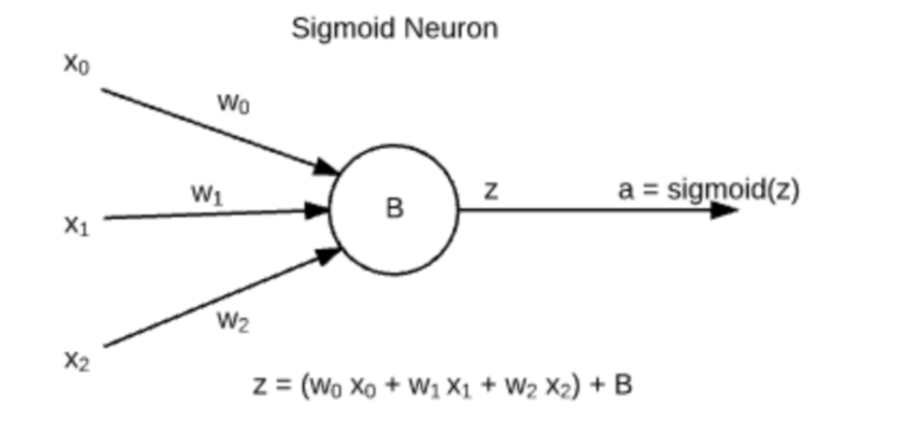
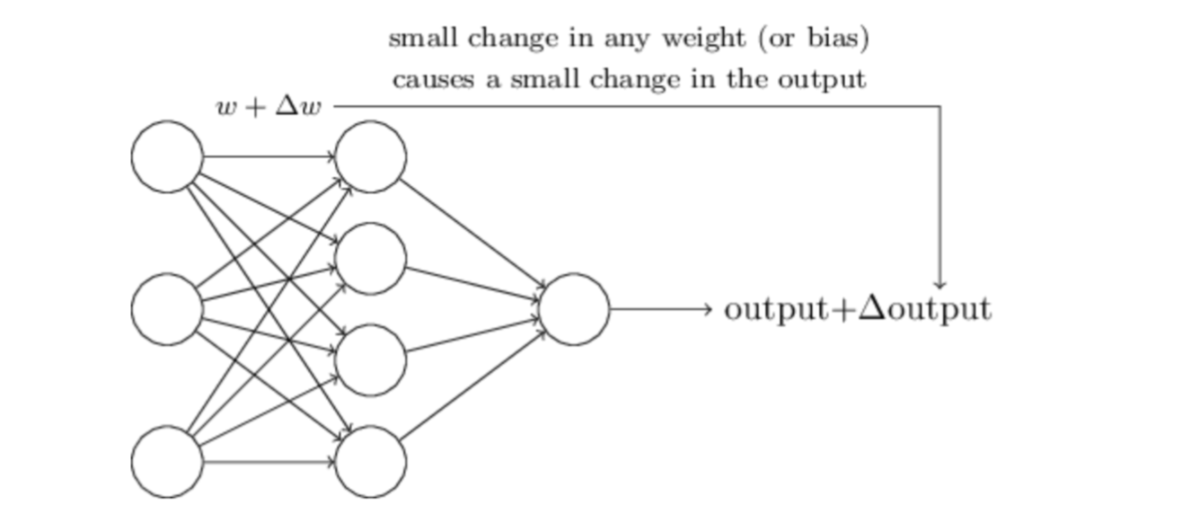
Handwriting Recognition - SNN

Slide 5
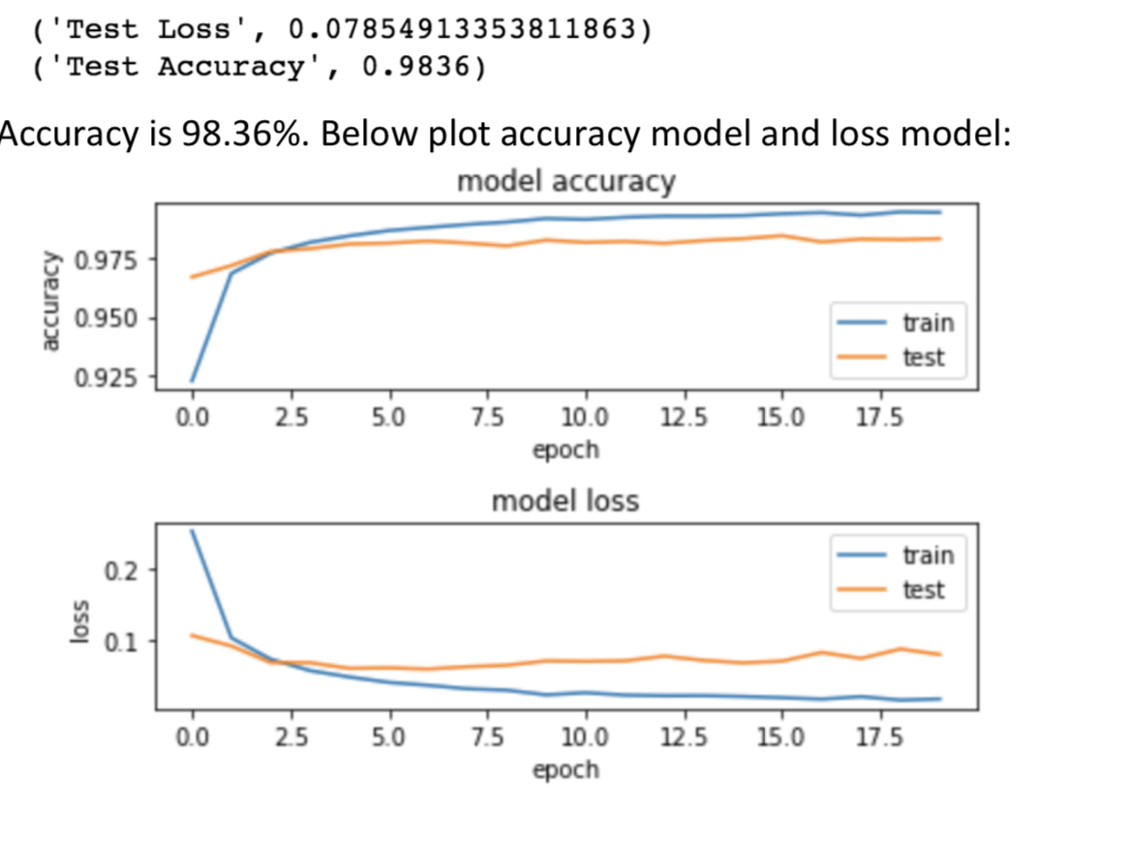
Handwriting recognition – SNN Result
Simple Neural Network, train model with epoch 20, the result:

Slide 6
Convolutional Neural Network (CNN)
In machine learning, a Convolutional Neural Network (CNN, or ConvNet) is a class of deep, feed-forward artificial neural networks that has successfully been applied to analyzing visual imagery. Convolutional Neural Networks are a type of neural network that makes the explicit assumption that the inputs are images, which allows us to encode certain properties into the architecture. There are three main types of layers to build ConvNet architectures: Convolutional Layer, Pooling Layer, and Fully-Connected Layer. We will stack these layers to form a full ConvNet architecture. - Wikipedia
CONV layer will compute the output of neurons that are connected to local regions in the input, each computing a dot product between their weights and a small region they are connected to in the input volume, POOL layer will perform a downsampling operation along the spatial dimensions (width, height) and FC (i.e. fully-connected) layer will compute the class scores, ( resulting in volume of size [1x1x10] in our case), where each of the 10 numbers correspond to a class score, such as among the 10 categories of CIFAR-10.

Slide 7
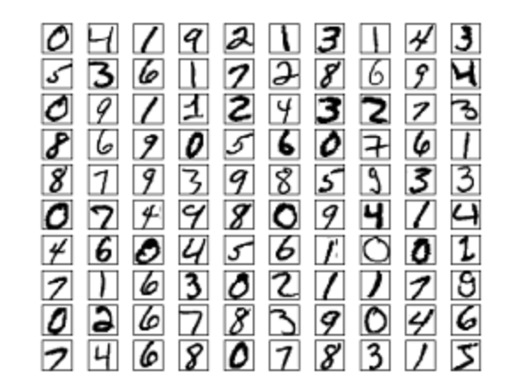
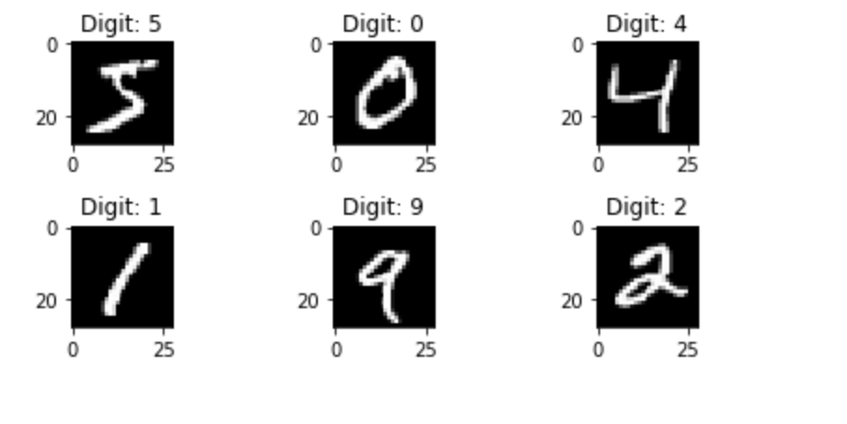
MNIST DataSet
Overview of MNIST dataset

Slide 8
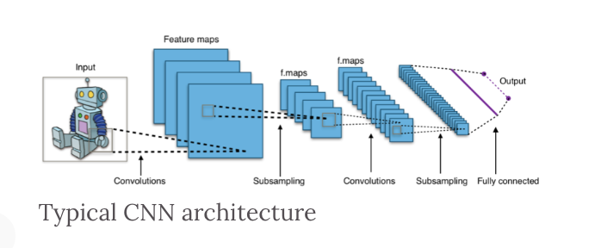
Convolutional Neural Network (CNN) - Typical Architecture

Slide 9
Building and compiling CNN model
sequential model.
stack Convolutional Layer and Pooling Layer on top of each other along with Dropout layer.
Dropout layers provide a simple way to avoid overfitting by randomly dropping components of neural network (outputs) from a layer of neural network.
The last layer of the neural network will have number of node equal to the number of output class i.e. 10 and the activation function we will be using is “softmax”.
This results in a scenario where at each layer more neurons are forced to learn the multiple characteristics of the neural network.

Slide 10
Pre-process dataset
Reshape dataset (resizing, normalizing the pixels values.
After doing the necessary processing on the image informations, the label data i.e. y_train and y_test need to be converted into categorical formats like label ‘3’ should be converted to a vector [0, 0, 0, 1, 0, 0, 0, 0, 0, 0] for model building.

Slide 11
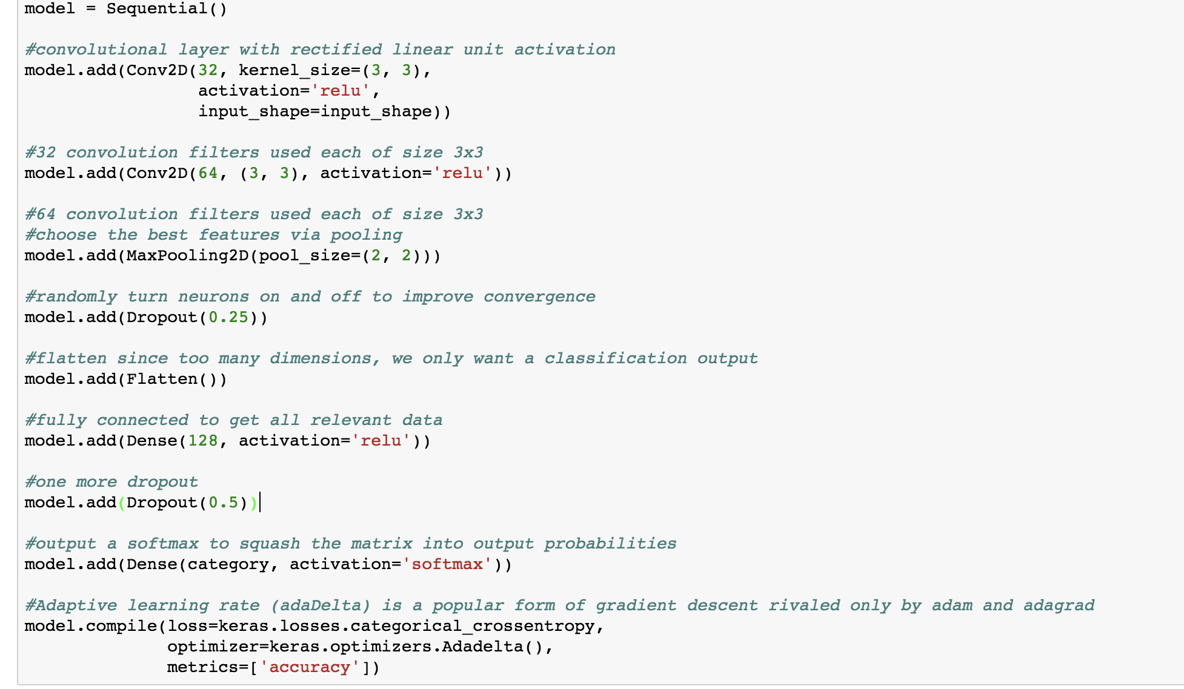
Building and compiling model

Slide 12
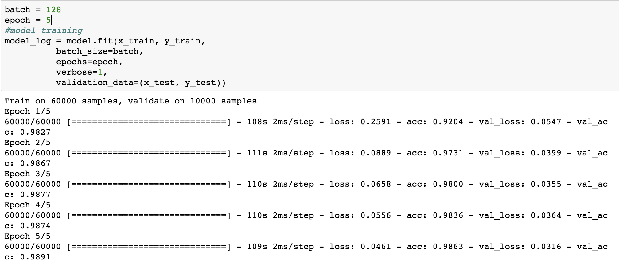

Slide 13
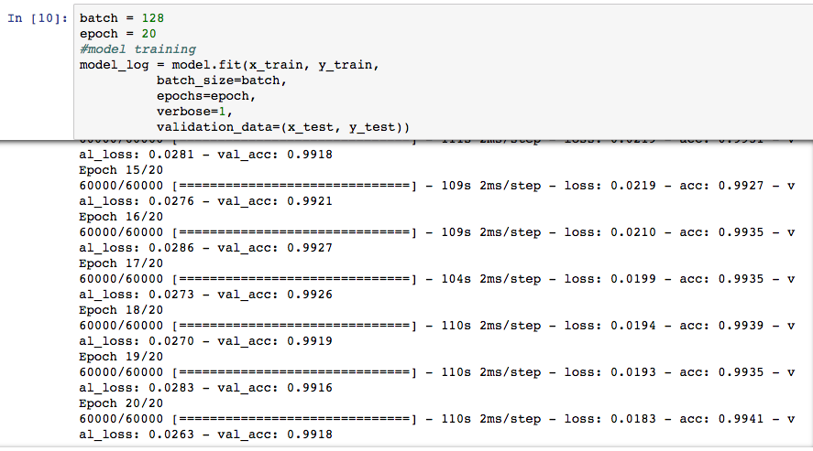
CNN train model with epoch = 20

Slide 14
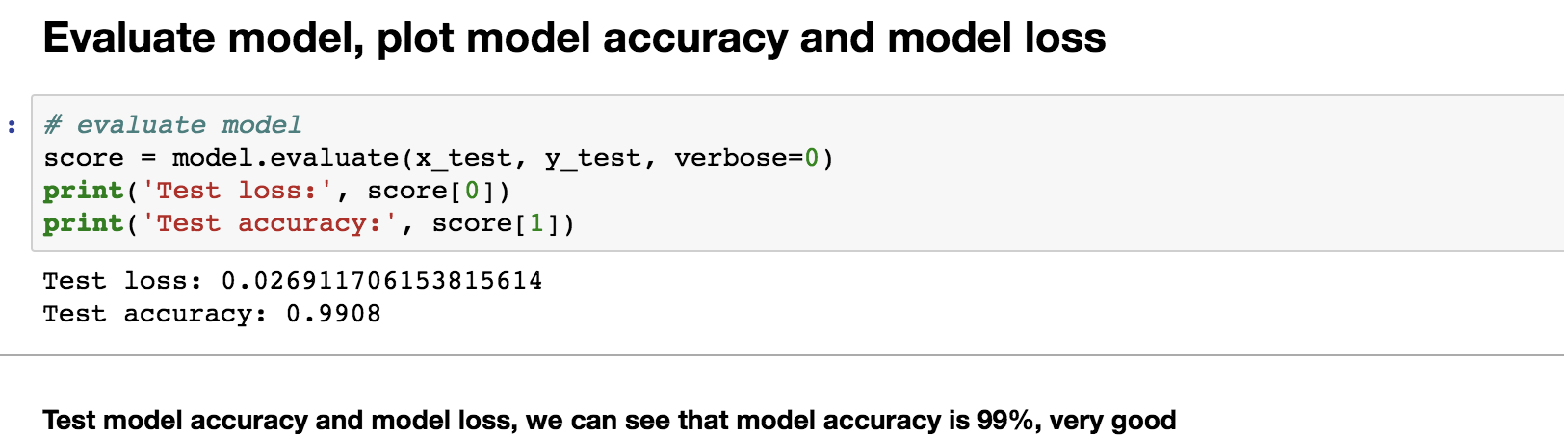
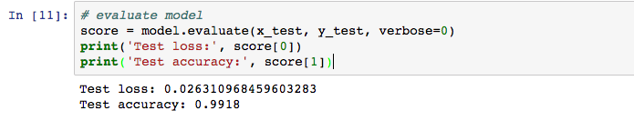
CNN Result with training 5 epoch and 20 epoch

Slide 15
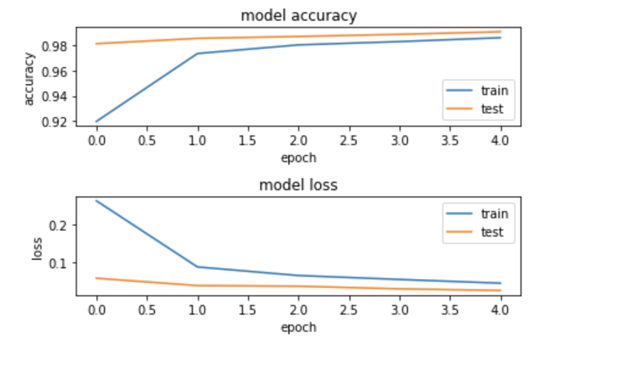
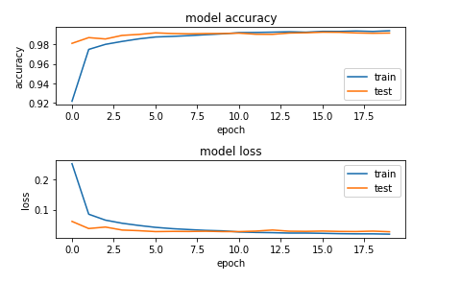
Model accuracy and loss plot (5 epoch and 20 epoch)

Slide 16
Model summary
_________________________________________________________________ Layer (type) Output Shape Param # ================================================================= conv2d_5 (Conv2D) (None, 26, 26, 32) 320 _________________________________________________________________ conv2d_6 (Conv2D) (None, 24, 24, 64) 18496 _________________________________________________________________ max_pooling2d_3 (MaxPooling2 (None, 12, 12, 64) 0 _________________________________________________________________ dropout_5 (Dropout) (None, 12, 12, 64) 0 _________________________________________________________________ flatten_3 (Flatten) (None, 9216) 0 _________________________________________________________________ dense_4 (Dense) (None, 128) 1179776 _________________________________________________________________ dropout_6 (Dropout) (None, 128) 0 _________________________________________________________________ dense_5 (Dense) (None, 10) 1290 ================================================================= Total params: 1,199,882 Trainable params: 1,199,882 Non-trainable params: 0

Slide 17
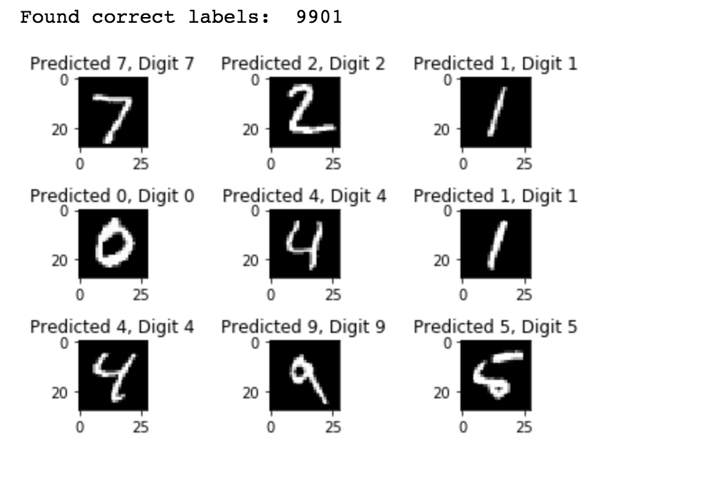
Predict

Slide 18
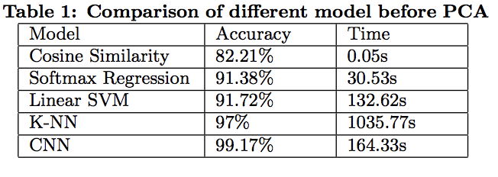
Compare to other models

Slide 19
Thank you!

